Slide 1
TLS Receive Side Crypto Offload to NIC
Boris Pismenny
Novmember 2017

Slide 2
Overview
Background
Motivation
Control Path
Model
Data Path
Summary
Discussion

Slide 3
TLS Record Protocol: Application Data
User Space: Application Data
Data
KTLS:
Fragment (2^14)
Data1
Data2
Data3
KTLS:
Encrypt & Authenticate
Enc(Data1) | T
Enc(Data2) | T
Enc(Data3) | T
KTLS:
TLS Records
H | Enc(Data1) | T
H | Enc(Data2) | T
H | Enc(Data3) | T
TCP:
Segment (MSS)
P1 | P2 | P3 | P4 | P5 | P6 | P7
H – TLS Record Header
T – TLS Record Authentication Tag
Notes:
Data -> TLS Data Fragments
H – header
T – authentication tag

Slide 4
TLS Crypto Offload vs. Other Protocols
Ideally, packets would be processed independently:
  IPsec
  DTLS
  QUIC
However, in TLS each record is processed independently
Each record has an Out-Of-Band sequence number that is used for decryption
Intermediate record state must be tracked by hardware
  Used by subsequent packets that are part of a previous record
TLS Records:
TLS Record 1 | TLS Record 2
TCP Packets:
P1 | P2 | P3
Notes:
TLS Record 1 | TLS Record 2 ➔ P2

Slide 5
Motivation
Setup: Two Xeon E5-2620 v3 machines connected back-to-back with Innova-TLS-Tx NICs (ConnectX4-Lx + Xilinx FPGA)
Run IPerf2 with a patch to use OpenSSL for the handshake
Compare the data path of the following:
  OpenSSL 1.1.0e SSL_write/SSL_read
  Kernel TLS send/recv with offload
  TCP send/recv (upper bound)
Everything is normalized to SSL_write/SSL_read

Slide 6
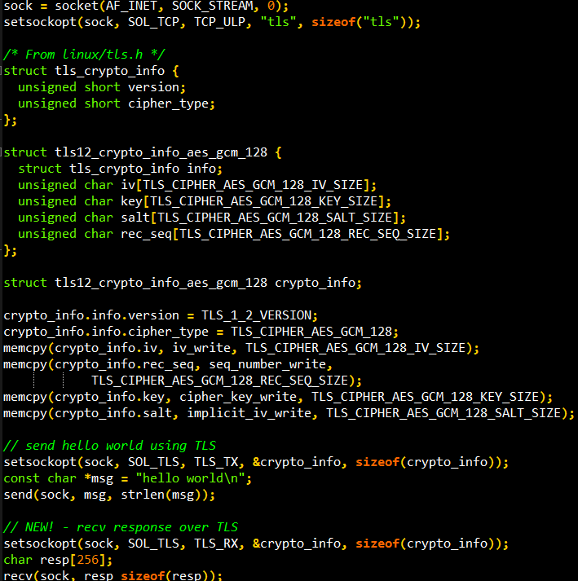
Control Path
kTLS is Now Upstream!
  Currently, only send-side
User interface
  Starts with a TCP connection
  Enable kTLS with setsockopt()
    Redirects user Send() call to kTLS functions, which calls do_tcp_sendpages()
Straightforward uAPI extension for Rx
  TLS_RX socket option
  TLS recvmsg replaces TCP recvmsg

Slide 7
Model
Offload initialization requires:
  Crypto material (keys, cipher)
  5-tuple
  TCP sequence number of next TLS record
  TLS record sequence number of next TLS record
Hardware decrypts in-order incoming packets
  Headers are unmodified - only the payload is processed
  OOO packets are unmodified
Software stack is unchanged
  kTLS (without crypto)
  TCP/IP
  Congestion control
  Memory management
KTLS
TLS record plaintext
byte stream*
TCP
TCP segments of
plaintext TLS records*
NIC
TCP segments of
ciphertext TLS records
Network
*While receiving, there might be both plaintext and ciphertext packets
Notes:
Mark socket as offloaded
Data path is unchanged*
tcpdump - plaintext

Slide 8
Data Path – Fast Path
1) Check all packets in record are decrypted – OK
2) Copy plaintext data to userspace
TLS Records:
TLS Records:
TLS Records:
TLS Record 1 | TLS Record 2 | TLS Record 3
Legend:
Decrypted
TCP Packets:
TCP Packets:
TCP Packets:
P1 | P2 | P3 | P4 | P5 | P6 | P7

Slide 9
Data Path – Slow Path (Partial Decryption)
1) Check all packets in record are decrypted – Wrong!
1.1) Is some part of the record decrypted? – OK
1.1.1) Partial decryption: Decrypt the remaining packets in software.
2) Copy plaintext data to userspace
TLS Records:
TLS Records:
TLS Records:
TLS Record 1 | TLS Record 2 | TLS Record 3
Legend:
Decrypted
Partially Decrypted
TCP Packets:
TCP Packets:
TCP Packets:
P1 | P2 | P3 | P4 | P5 | P6 | P7

Slide 10
Data Path – Slow Path (Resync)
1) Check all packets in record are decrypted – Wrong!
1.1) Is some part of the record decrypted? – Wrong!
1.1.1) Partial decryption: Decrypt the remaining packets in software
1.2) Otherwise, the record is ciphertext – use the software crypto implementation
1.2.1) Call the driver for HW Resynchronization
2) Copy plaintext data to userspace
TLS Records:
TLS Records:
TLS Records:
TLS Record 1 | TLS Record 2 | TLS Record 3
Legend:
Decrypted
Partially Decrypted
Encrypted
TCP Packets:
TCP Packets:
TCP Packets:
P1 | P2 | P3 | P4 | P5 | P6 | P7

Slide 11
Partial Decryption
Observations:
In AES counter mode, given the counter (IV) and the key – it is possible to generate the keystream
  Ciphertext = Plaintext XOR Keystream
Partial Decryption Algorithm*:
Calculate keystream by encrypting zeros
For each plaintext packet XOR with keystream to obtain ciphertext
Decrypt and authenticate the ciphertext record
Return plaintext and authentication result
TLS Records:
TLS Record 1 | TLS Record 2 | TLS Record 3
Legend:
Decrypted
Partially Decrypted
TCP Packets:
P1 | P2 | P3 | P4 | P5 | P6 | P7
*This algorithm could be optimized to use one pass over the data instead of two passes as described here.

Slide 12
Resynchronization
After packet drop/out-of-order hardware looses the following state required to offload the next TLS record:
  Location of TLS record frames in the TCP stream
  TLS record sequence number for each frame
SW assistance is needed!
Resynchronization process
  kTLS requests driver to resynchronize for every received record that was not decrypted
    kTLS provides driver with TCP SN corresponding to first byte of record
  Driver attempts to resynchronize HW based on this information
Note: Hardware will not decrypt any packet until resync is accepted by software.

Slide 13
Optimizing Initial Synchronization
Consider the following scenario:
The user requests TLS offload after reading X bytes of data from TCP
At this time, the kernel has Y > X bytes of data in the receive queue
At the same time, hardware processed Z > Y > X bytes of data
Problem: Offload requires the state at the last record within Z bytes.
We suggest two techniques to mitigate this:
  The kernel walks the receive queue and provides hardware with the TCP sequence of the most recent TLS record
  Resync flow in HW
TLS records:
R1 | R2 | R3
TCP packets processed by userspace:
P1 | P2 | P3
TCP packets processed by the kernel:
P1 | P2 | P3 | P4 | P5
TCP packets processed by hardware:
P1 | P2 | P3 | P4 | P5 | P6 | P7

Slide 14
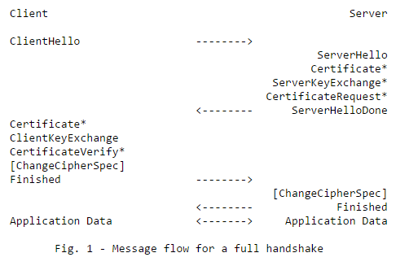
TLS Renegotiation
Before the ChangeCipherSpec (CCS) message the all data is encrypted using the old keys, after the CCS message all data is encrypted using new keys
old keys
old keys
new keys
new keys

Slide 15
TLS Renegotiation
Assume packets are received in order during TLS key renegotiation
TLS Change Cipher Spec record is not identified by hardware, as a result old keys are used to decrypt data that was encrypted using new keys
When kTLS first observes the CCS message:
  Request hardware to stop offload
  Walk all received packets and re-encrypt bad decrypted packets
encrypted using old key
encrypted using new key
TLS records:
R1 | R2 (CCS) | R3 | R4
decrypted using old key
Authentication error
Stop decryption
TCP packets:
P1 | P2 | P3 | P4 | P5 | P6 | P7 | P8 | P9

Slide 16
Summary
Problem 1: During initialization hardware already processed the next TLS record
  Resync
  Kernel provides the TCP sequence of the last record received to HW
Problem 2: Hardware lost track of TLS records in the TCP stream due to packet drop/reorder
  Resync
Problem 3: Old keys are used to decrypt data that was encrypted using new keys after a TLS Change Cipher Spec record is not identified by hardware
  kTLS will re-encrypt packets that were decrypted using the old key after processing CCS
Problem 4: Some TLS records contain both ciphertext and plaintext packets
  Partial decryption

Slide 17
Discussion
Need to pass 2 bits of metadata in the SKB
  crypto_done – was packet processed by hardware?
  crypto_success – was any error encountered during this packet’s processing?
Prevent coalescing of plaintext and ciphertext SKBs
  tcp_collapse/gro must not coalesce ciphertext and plaintext
TCP OOO queue might get bloated with plaintext-ciphertext-plaintext-…
  Could re-encrypt packets in OOO queue when pruning
crypto_done && !crypto_success
  HW might continue processing a packet after encountering an error in the middle of it
  Call netdevice from kTLS to fix packet – revert the HW operation in software
TLS offload uses CHECKSUM_UNNECESSARY
  CHECKSUM_COMPLETE is meaningful only for the ciphertext that was replaced.
Notes:
Could we combine TLS skb metadata with IPsec’s sec_path?

Slide 18
Thank You

Slide 19
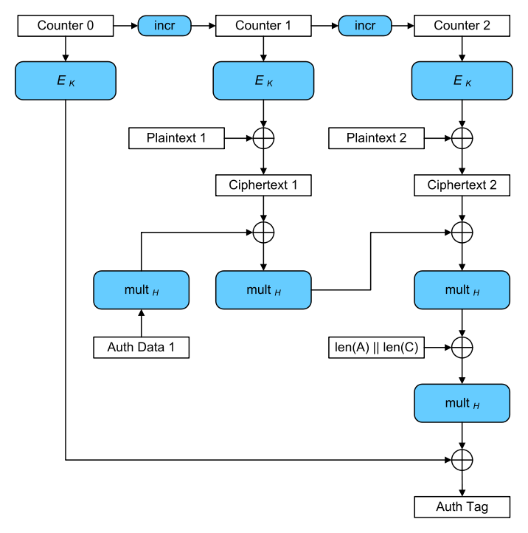
Partial Decryption
Observations:
Given the counter (IV) and the key - GCM allows for decryption of any cipher block in the record.
  XOR ciphertext block with E_k(Counter + BlockNumber)
Authentication tag is computed over the ciphertext
Algorithm:
Calculate keystream by encrypting the counters
For each ciphertext block
  If plaintext: XOR with keystream to obtain ciphertext and multiply ciphertext with H
  If ciphertext: XOR with keystream to obtain plaintext and and multiply ciphertext with H
Check authentication tag
Return plaintext and authentication result.

